Slide 1
Method Invocation Pattern In Javascript
Yanshik Rajput
ASET

Slide 2
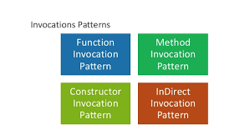
Types Of Method invocation Pattern in Javascript

Slide 3
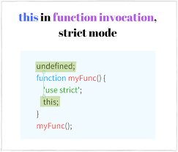
Function Invocation Pattern:

Slide 4
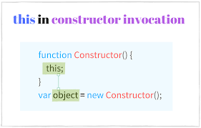
Constructor Invocation Pattern:

Slide 5
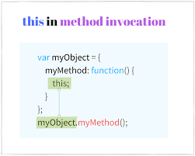
Method Invocation Pattern:

Slide 6
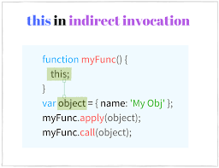
Indirect Invocation Pattern:

Slide 7
THANK YOU

